Slide 1
How to create S3 event notifications using an SNS Topic

Slide 2

Objective/scope of the project :-
Objective:
To automatically notify users or systems when a specific event (like a file upload) occurs in an S3 bucket by integrating Amazon S3 with Amazon SNS and Amazon SQS.
Scope:
Configure Amazon S3 to monitor specific events (e.g., object creation). Use Amazon SNS as the destination to send event notifications. Allow multiple subscribers (e.g., email, Lambda, HTTP endpoint) to receive notifications in real-time. Ensure secure communication by setting the correct permissions and policies between S3 and SNS.

Slide 3
List of Services integrated :-
1- Simple Queue Service (SQS)
2- Simple Notification Service (SNS)
3- Simple Storage Service (S3)

Slide 4
Scope and use case of the services integrated :-
1. Simple Queue Service (SQS)
• Scope: SQS sends, stores, and receives messages between different parts of a system without losing any messages.
• Use Case: Imagine an online shopping website. When a customer places an order, the order goes into a queue (SQS). Another part of the system picks it up from the queue to process it. This way, the website doesn’t slow down and can handle many orders at once.
2. Simple Notification Service (SNS)
• Scope: Publish-subscribe messaging and mobile notifications.
• Use Case: Sending alerts to users or triggering automated workflows (e.g., notifying users of system events or sending SMS/email alerts).
3. Simple Storage Service (S3)
• Scope: Scalable object storage for data backup, archiving, and analytics.
• Use Case: Storing user-generated content like images or videos, backups, and any data for analytics.

Slide 5
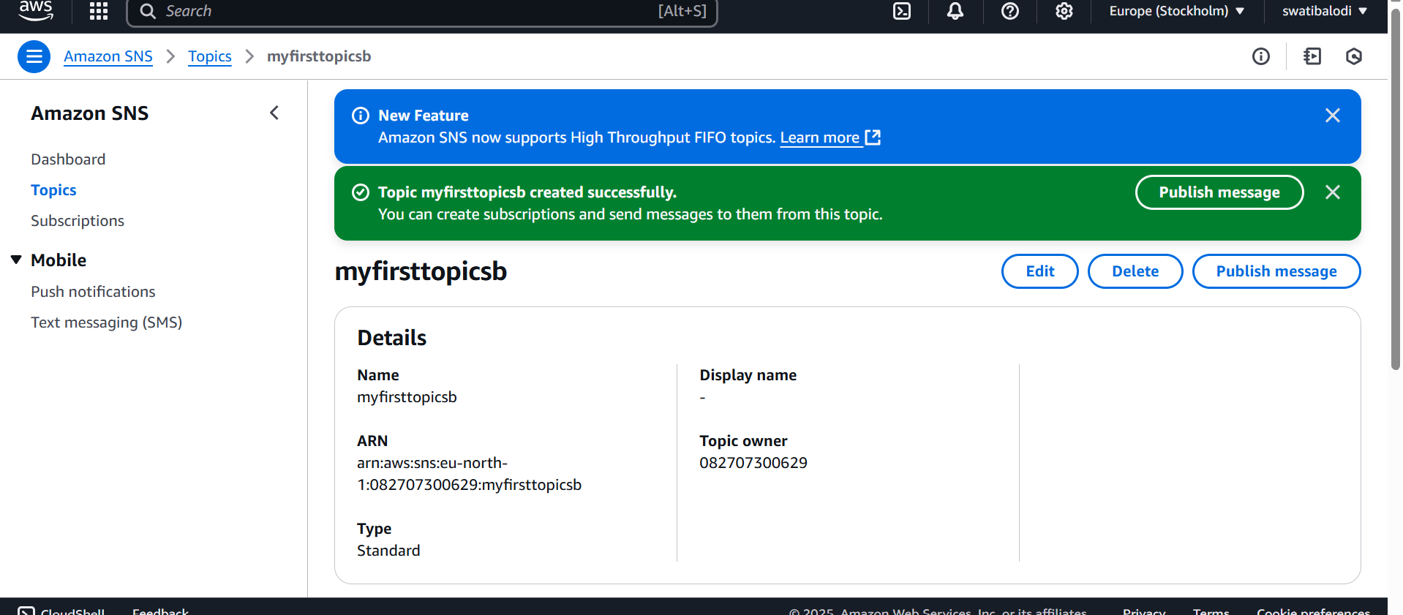
Screenshots of the outputs of practical work done:-

Slide 6
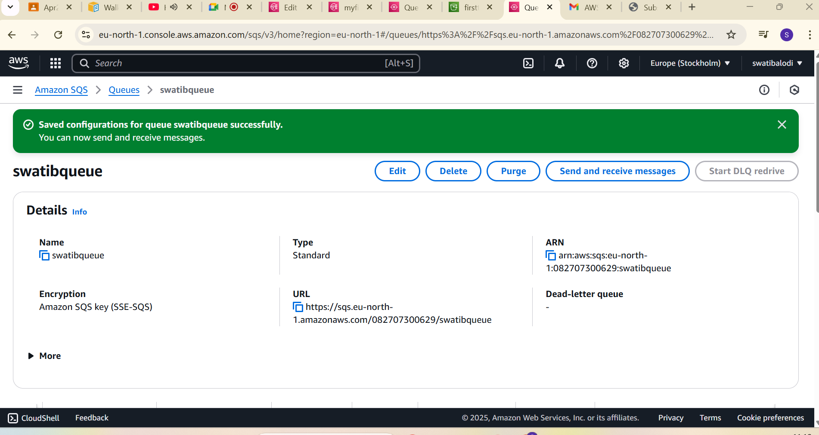
Screenshots of the outputs of practical work done:-

Slide 7
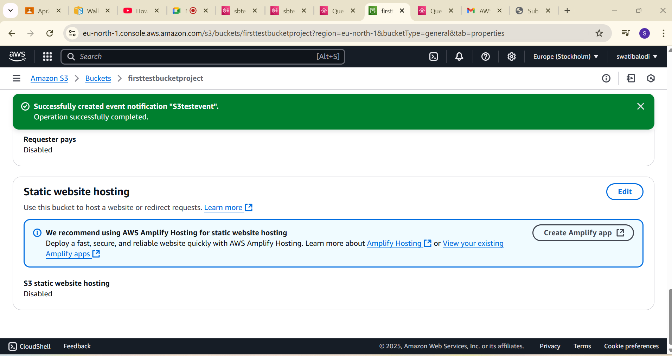
Screenshots of the outputs of practical work done:-

Slide 8
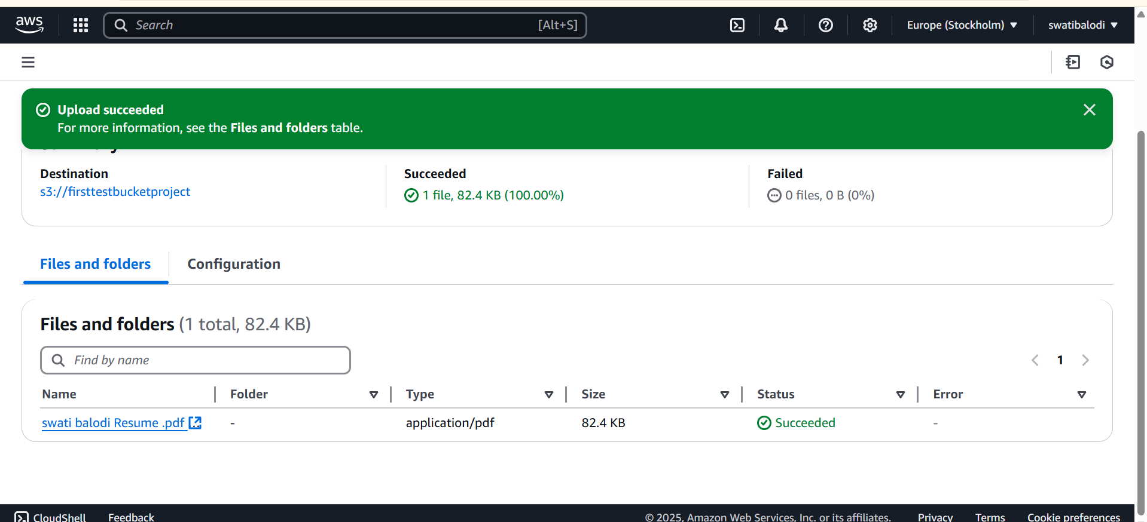
Screenshots of the outputs of practical work done:-

Slide 9
Challenges faced :-
I started creating SNS topic first instead of creating SQS topic.
I was giving wrong sourcearn which lead

Slide 10
Thankyou
Project By Swati Kamlesh Balodi.

